Slide 1



Slide 2

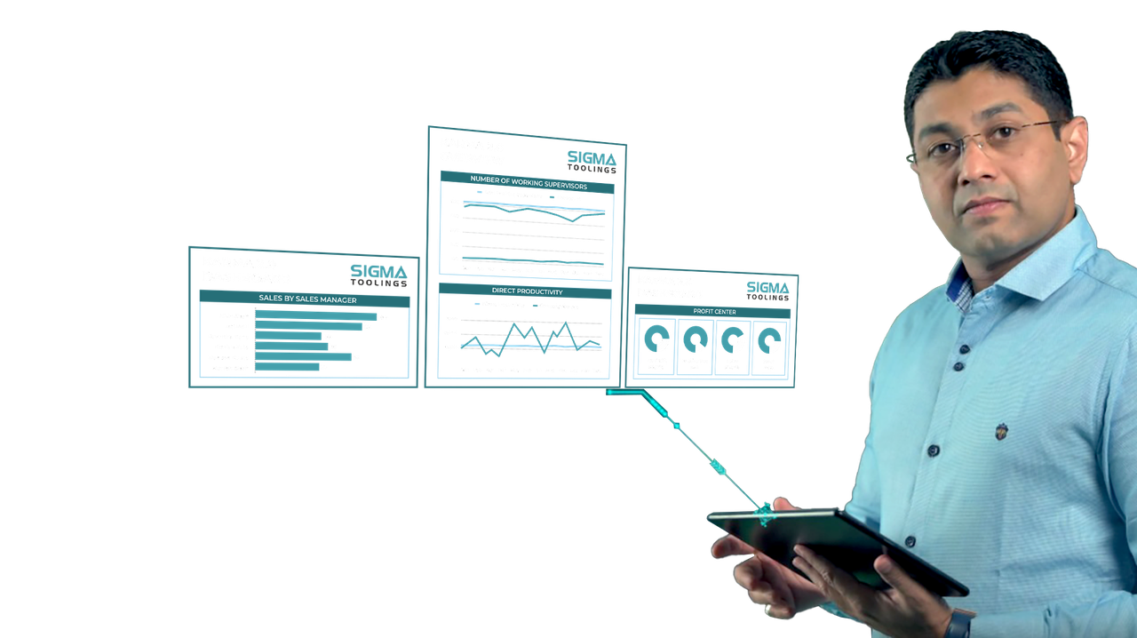
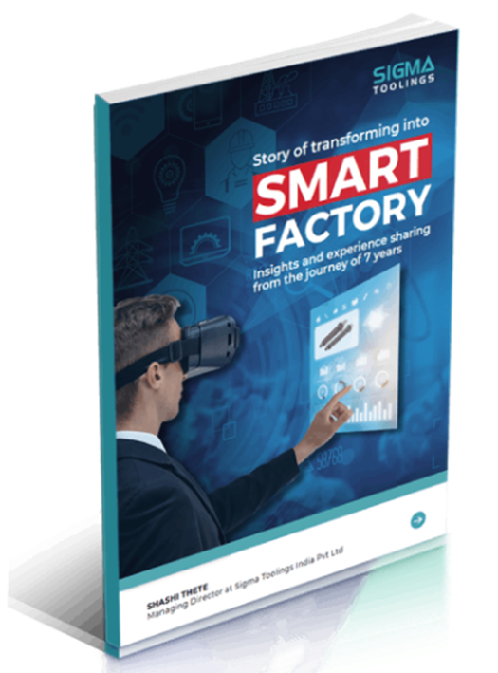
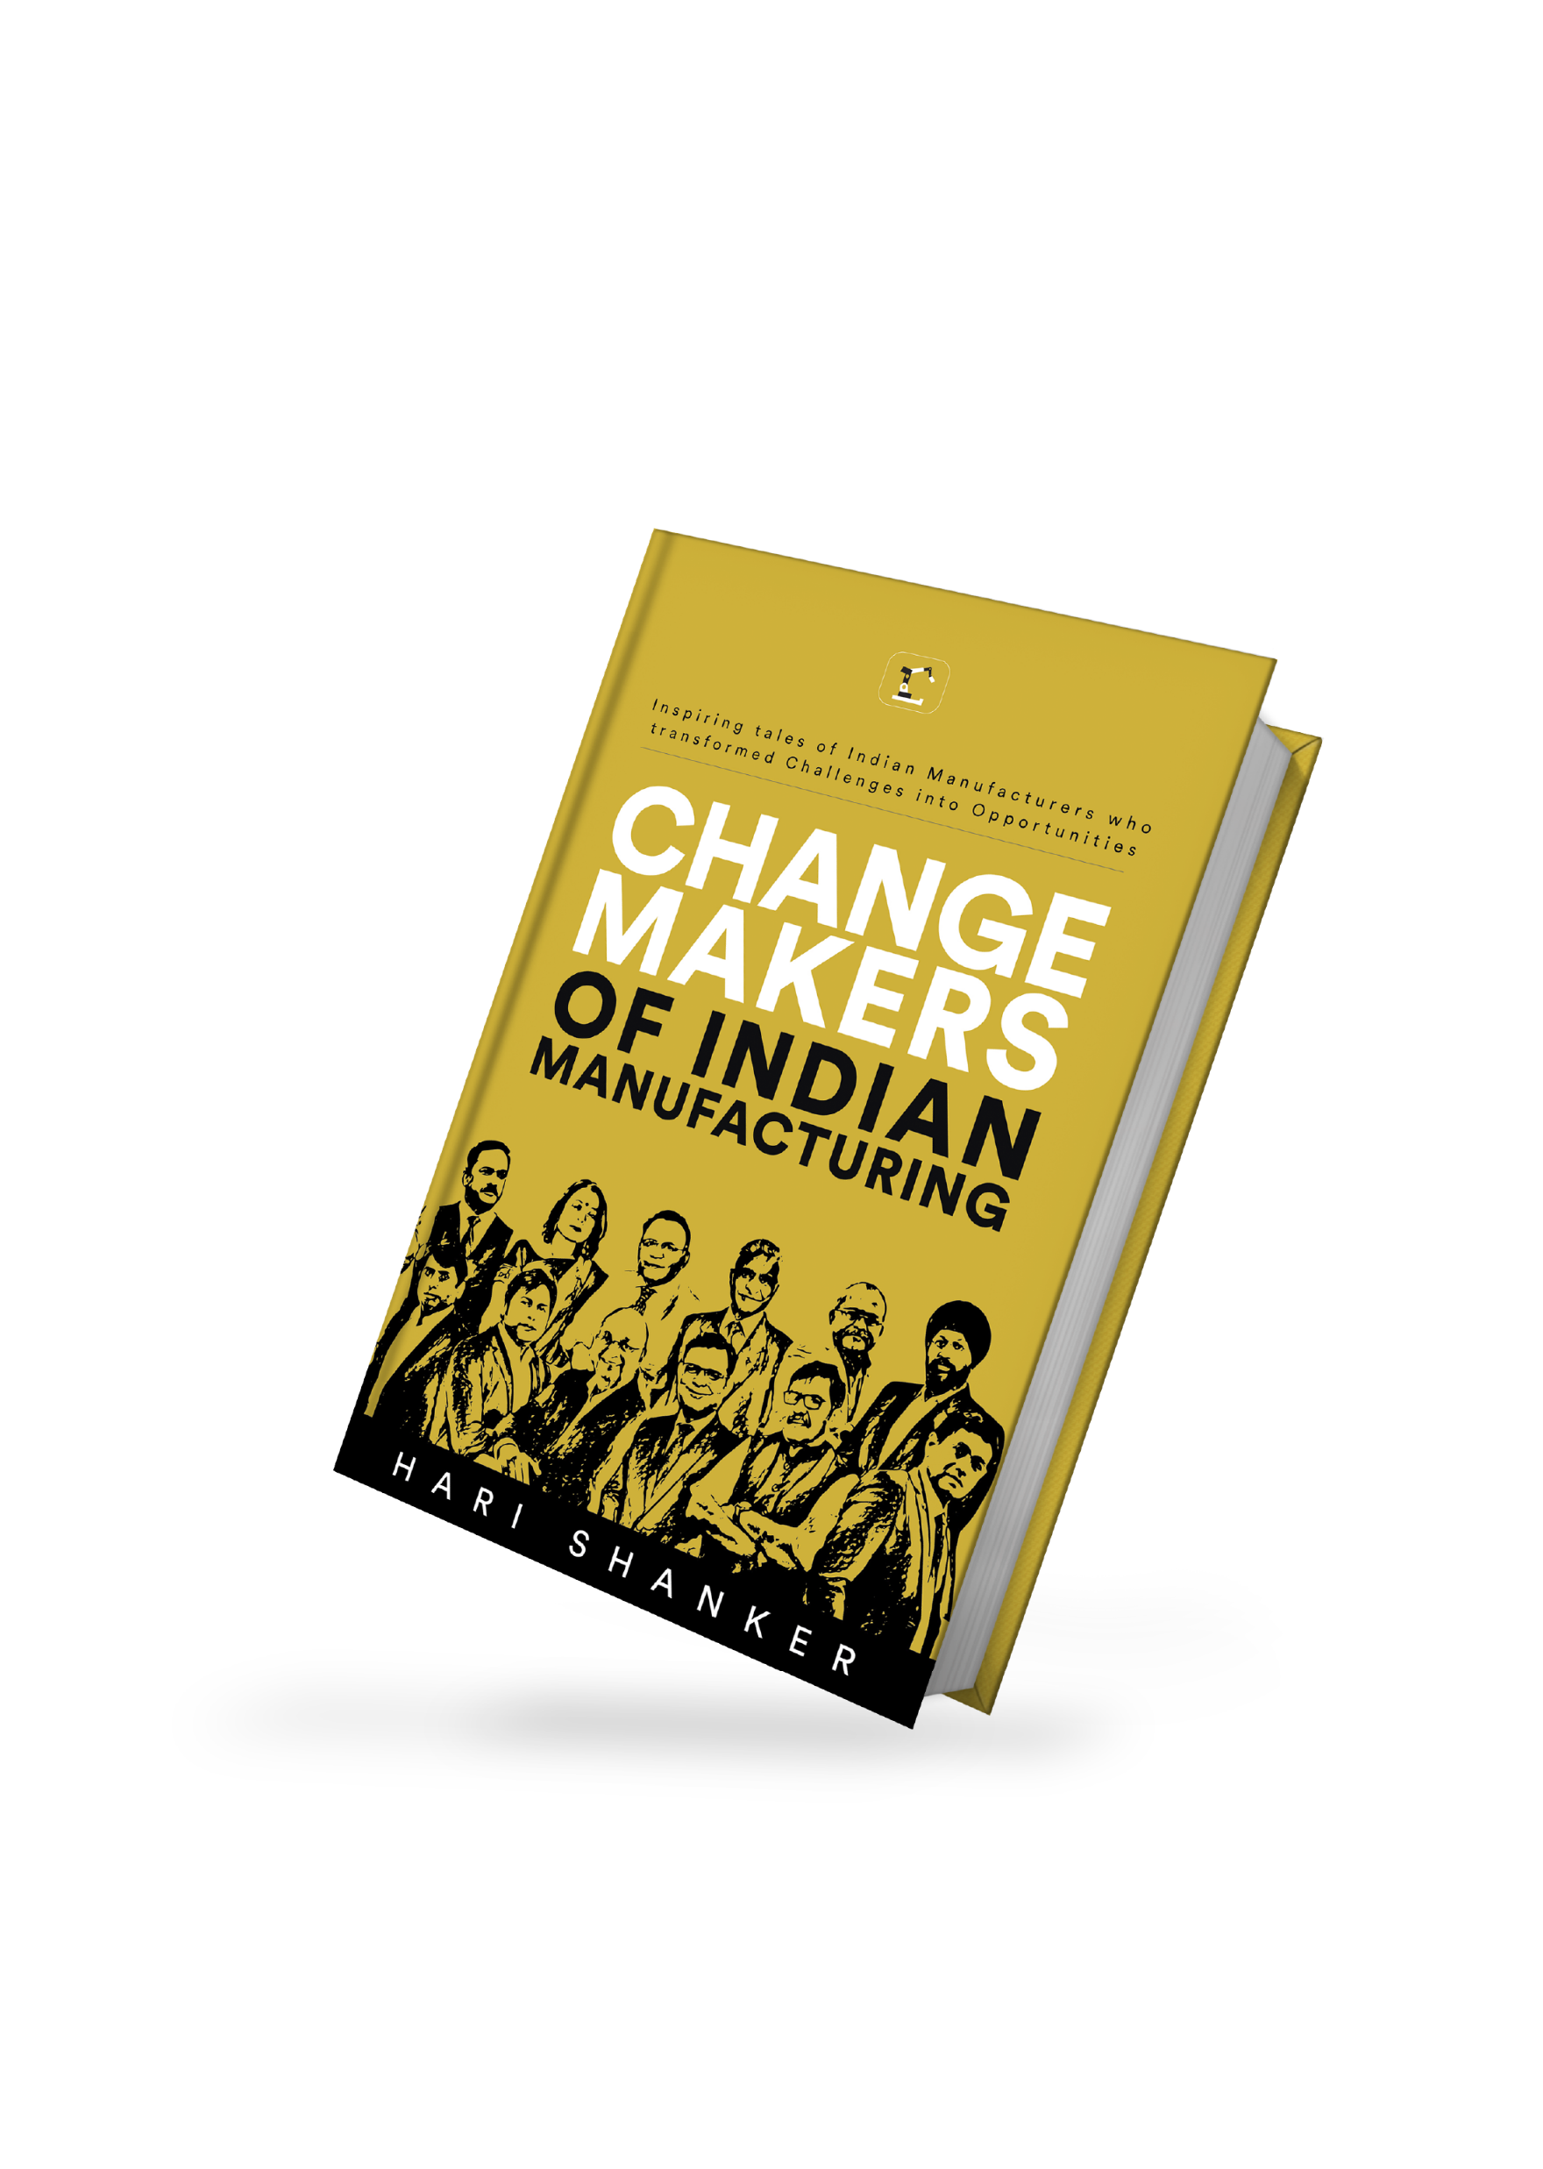
About Me
Founder and Managing Director
  Sigma Toolings India Pvt Ltd
  InnovationTech Synergies India Pvt ltd
Board of Director : InnovationTech Ltd Bulgaria
Smart Factory Leader
Mentoring Over 90 Companies-TLC
Iyengar Yoga Practitioner
Value-driven, forward-thinking leader
Author of the Book: Smart Factory
www.sigmatoolings.com | www.sigmatiz.com | www.shashithete.com

Slide 3

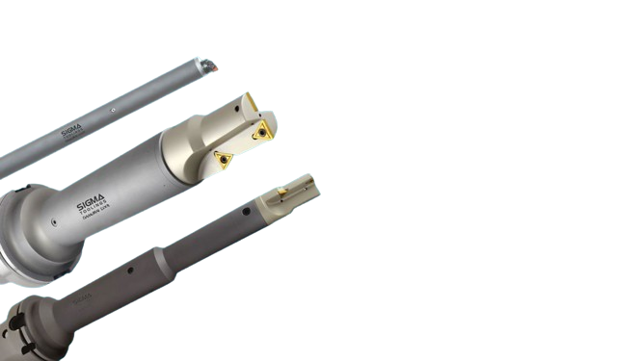
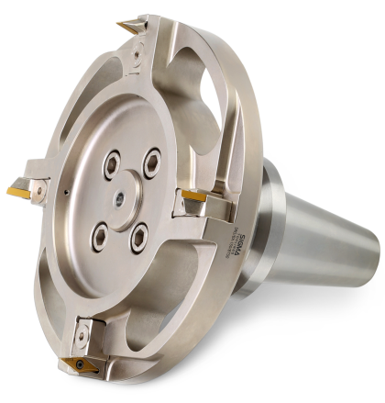
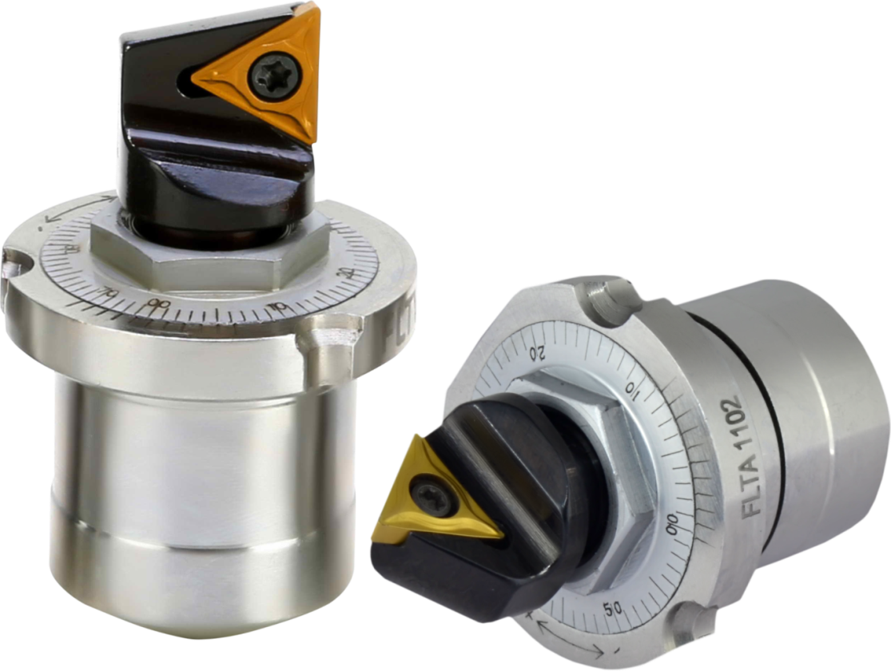
Sigma Toolings India Pvt Ltd
Sigma Toolings India Pvt Ltd, is the No. 1 company in Customized Tooling Solutions for Boring, Milling, Cutting and Drilling
Founded in 2001, Sigma Toolings quickly emerged as a market leader in customized, high-end tooling solutions in India. Sigma Toolings has been at the forefront of adopting futuristic Industry 4.0 technologies for its own manufacturing as well as the products.
Today, Sigma is one of the few Tooling solutions providers in India to have a dedicated company for R&D and innovations, leverage Artificial Intelligence for its solutions, and offer a digital Tooling product range with capabilities to deliver Project Management and Productivity Improvement.
www.sigmatoolings.com | www.sigmatiz.com | www.shashithete.com

Slide 4
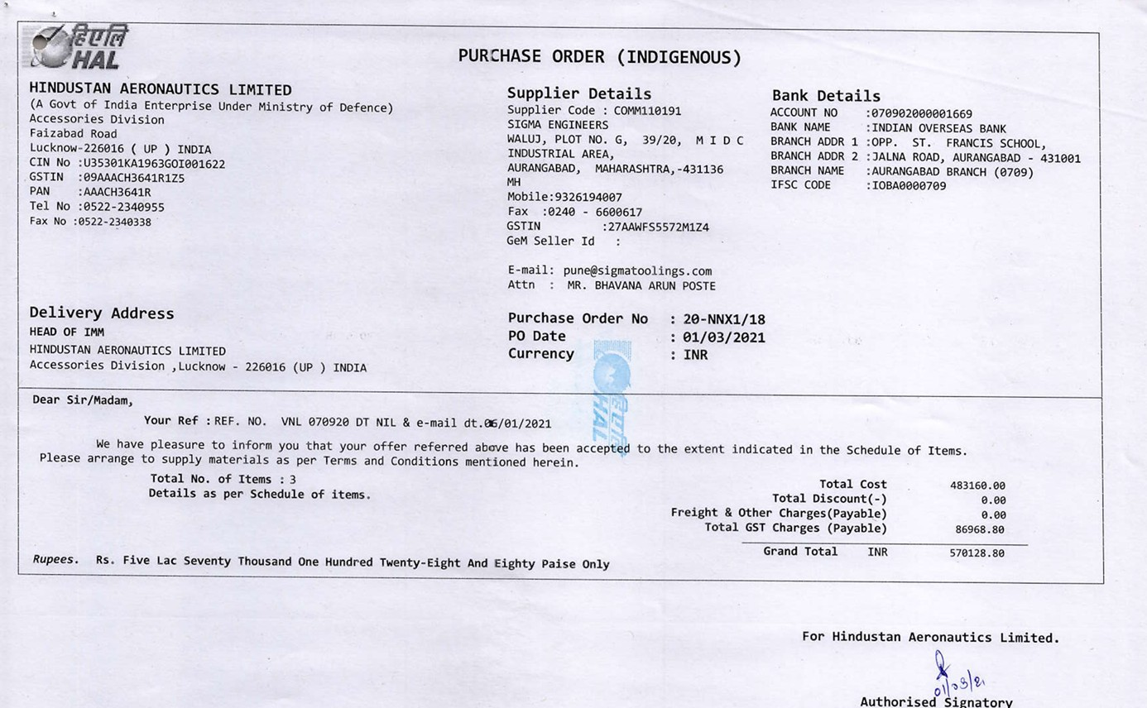
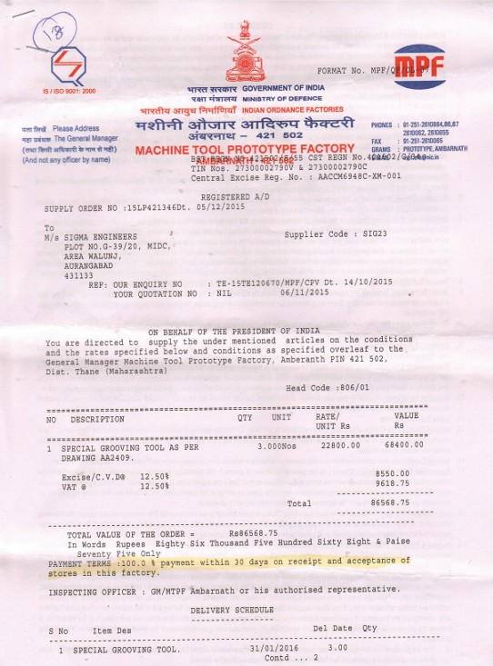

Sigma’s Gov Association
Sigma Toolings India Pvt Ltd has established partnerships within the government sector and has successfully delivered customized tooling solutions to various governmental organizations. These collaborations highlight Sigma's proficiency in catering to the specific needs of government entities, ensuring efficient and tailored solutions. Through these associations, Sigma has demonstrated its capability to meet the rigorous standards and requirements of the government sector, solidifying its position as a trusted partner in providing high-quality tools and services.
Hindustan aeronautics limited
Ordinance Factory Ambarnath
www.sigmatoolings.com | www.sigmatiz.com | www.shashithete.com
Shashi Thete
Founder and Managing Director

Slide 5

About Us
Innovation Tech India Pvt Ltd, where the convergence of brilliant minds fuels the journey towards transformative advancements.
Being a solution provider for industry 4.0 and QA 4.0 We are a collaborative force of visionary 70+ scientists connected Globally driven by a singular mission: to pioneer world-class, revolutionary technology that amplifies the quality of human life.
Our foundation rests on the belief that innovation is the catalyst for progress, and through relentless exploration and ingenuity, we aim to shape a future where groundbreaking solutions redefine possibilities. Join us on this exhilarating expedition as we push the boundaries of what's conceivable, dedicated to crafting innovations that empower and uplift humanity

Slide 6

The Working Layers
L1
Establishment
S1
Machine
S2
I 4.0
L2
Technology
S3
QA 4.0
L3
Transformation
S4
Benchmarking
O
50% Saving

Slide 7

The First Layer | Machine
The initial Layer involves a comprehensive evaluation of the plant, including an in-depth assessment of its operational needs and capabilities. A detailed survey report is then compiled, highlighting key findings and recommendations. Based on the evaluation, we propose and supply state-of-the-art, advanced machinery that is specifically tailored to ensure optimal integration with I4Q4 systems. This machinery is selected for its superior performance, efficiency, and alignment with cutting-edge technological standards, ensuring seamless and future-ready integration that supports enhanced operational effectiveness and long-term sustainability for the plant's needs.
1
Survey
2
Proposal
3
Machine Supply
6
Implementation
5
Training
4
Deployment

Slide 8

The Second Layer | Technology
The second Layer focuses on a thorough evaluation of the plant from a technological integration and deployment perspective. This includes assessing the plant's current systems and identifying areas for optimization through advanced technology. A comprehensive technical survey report is then generated, outlining key insights and recommendations for improvement. Based on the findings, we propose and deploy a world-class, advanced, and customized I4Q4 technology solution tailored to enhance your production capabilities and data analytics. This integration ensures seamless operations, greater efficiency, and real-time data-driven decision-making, empowering the plant for future growth and innovation.
1
Survey
2
Proposal
3
Integrations
6
Implementation
5
Training
4
Deployment

Slide 9

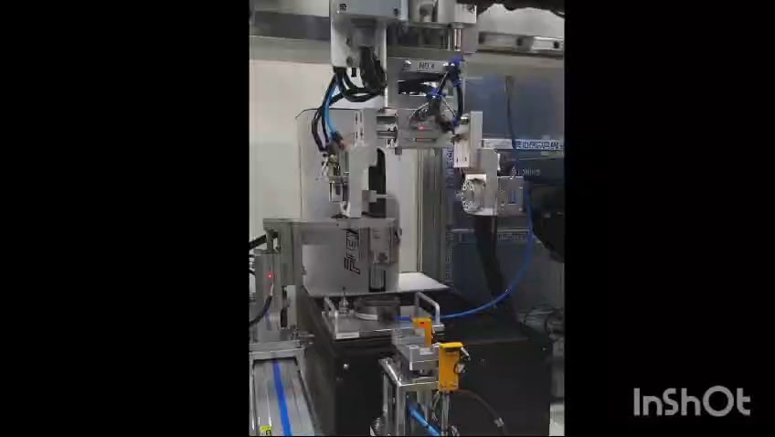

Revolutionizing 3D Automated Inspection!

Slide 10

Why InnovationTech
One Stop Solution for all I 4.0 & Q 4.0 needs
Complete On-Premise Solution
Faster Implementation
No Hardware for Data Acquisition for machines having data available on LAN port
Customized solutions as per your unique needs
Your Data Your Ownership – Business Model
Expertise in I 4.0 & Q 4.0 Solutions
Continuous Support and Training
Very easy to use Platform
Plug and Play System
Single System for all solutions

Slide 11

Scope of Work for Industry 4.0
Industry 4.0 Implementation
Foundry Monitoring
Machine Monitoring
Condition Monitoring/Predictive Maintenance
Core Shooter Machine Monitoring
Mold Making
Machines Monitoring
Furnace Monitoring
Machines Monitoring with data available on Ethernet Port
Mid Generation CNC / Press Machines
(Hard Wiring)
Conventional Machines (Lathe etc.)
Vibration
Temperature
Level
Pressure
Utility Monitoring / Building management System
Energy Monitoring
Compressor Monitoring
API Development
Linking data with ERP
Oil Quality
Water, Oil etc.
Energy Monitoring with Harmonics
FFT Analysis
Any machine generating electric signal

Slide 12
Industry 4.0 Impact
Additional Benefits
Real Time Accurate Data
Machine Utilization
Downtime Analysis
Man Hours Savings
Predictive Maintenance
Quality Control
Effective Job Scheduling/
Capacity Planning
ERP Integration
Attractive & easy to use Dashboard
In depth Reports Generation
Hourly Reports for effective analysis
Tool Life Monitoring
Man-Machine Material Reports
Service Support & Training
MIS Reports for Top Management
Machine Downtime Interlocking
Industry 4.0

Slide 13
Data Management
Input Data
Digital /Relay
Analog
System
M/C ON
Cycle ON
Part Count
Sensor Outputs

Slide 14
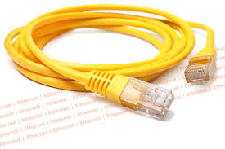
Data Management
Only LAN cable required
Complete On-Premise Solution
Faster Implementation
No Hardware for Data Acquisition for machines having data available on LAN port for most of the controllers
LAN Cable

Slide 15
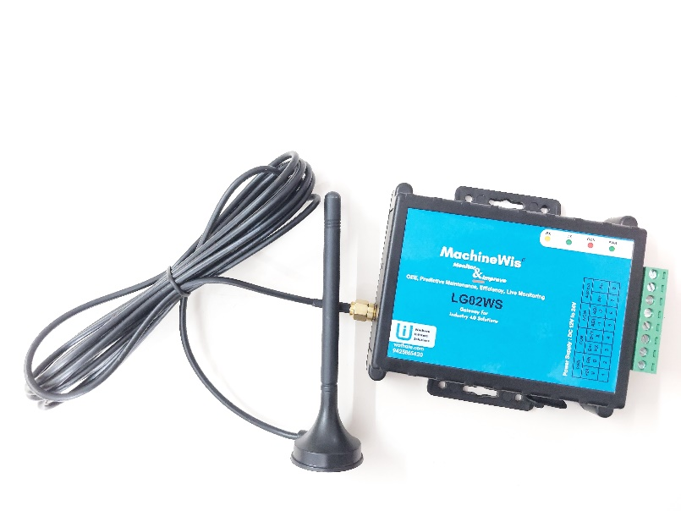
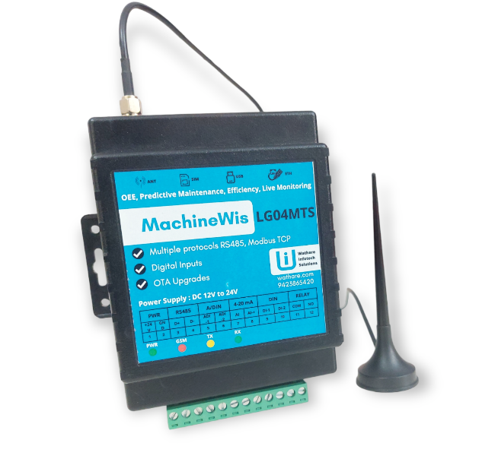
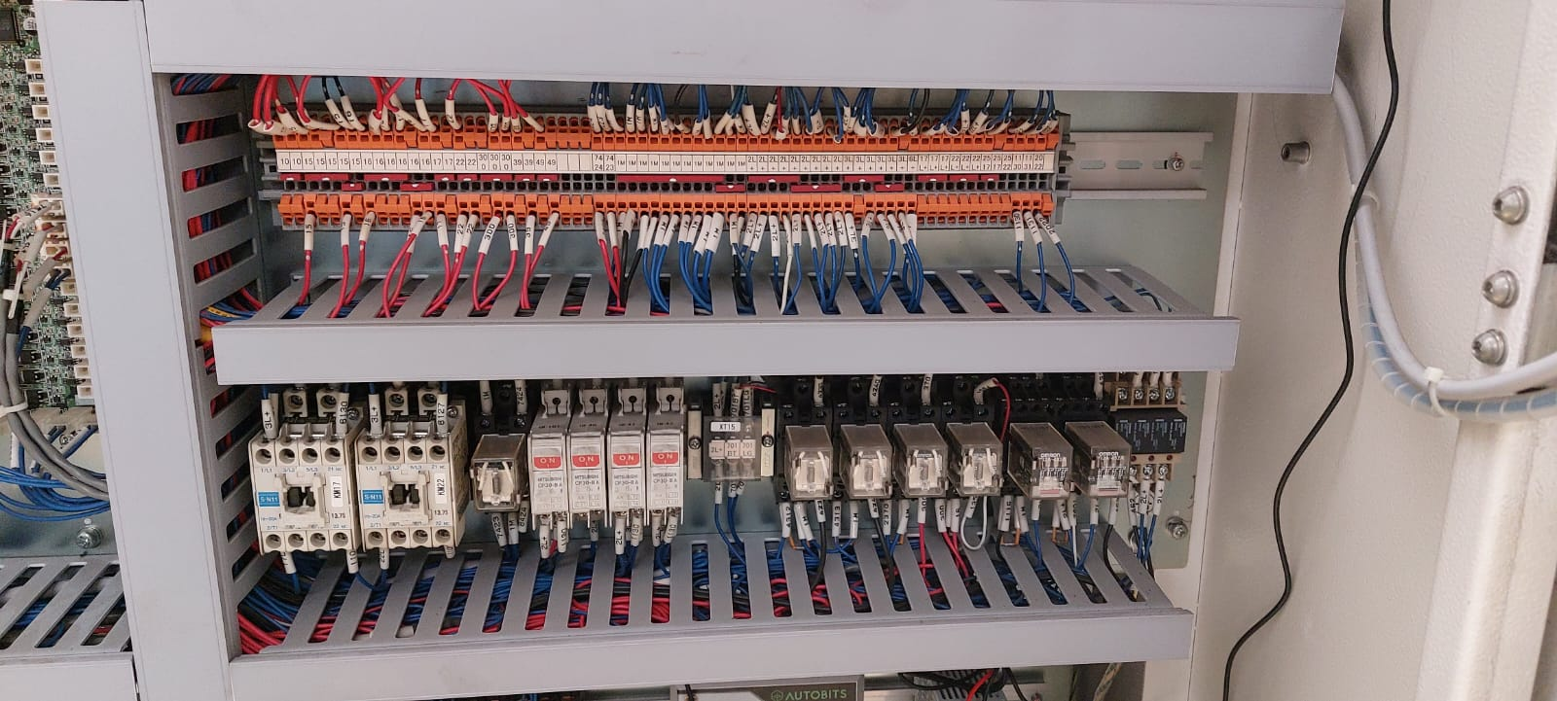
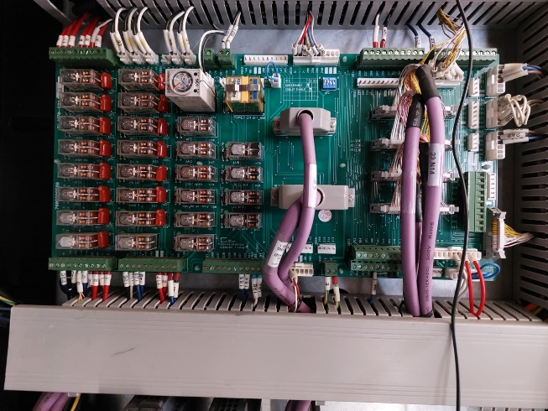
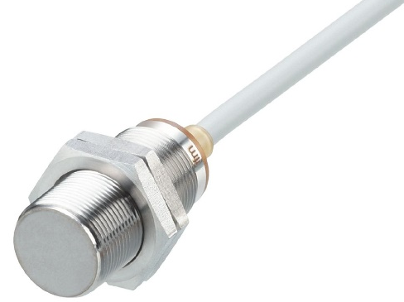
Digital Data Management
Where system data is not possible to extract
Hard wiring on relays
Relay – 230 V or 24 V
General method for most IOT data collection
Standard parameters from connection line number or tower lamp
If not available, need ladder update

Slide 16
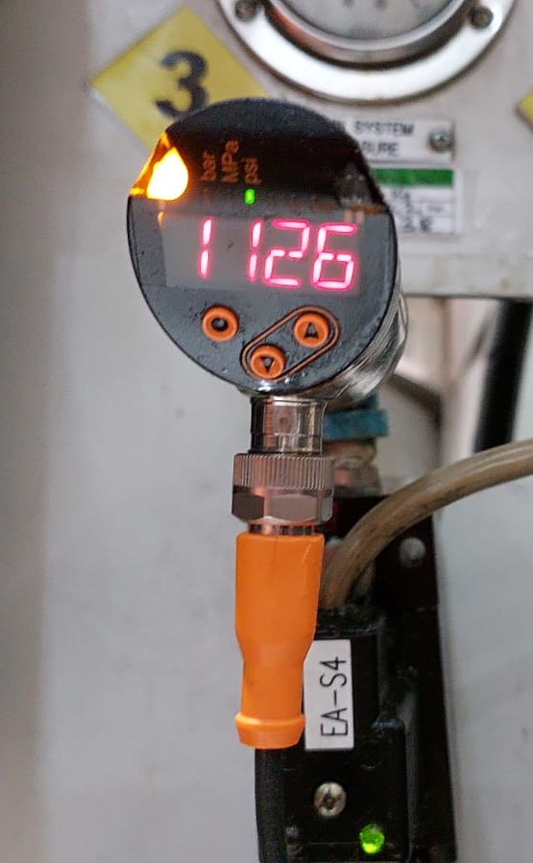
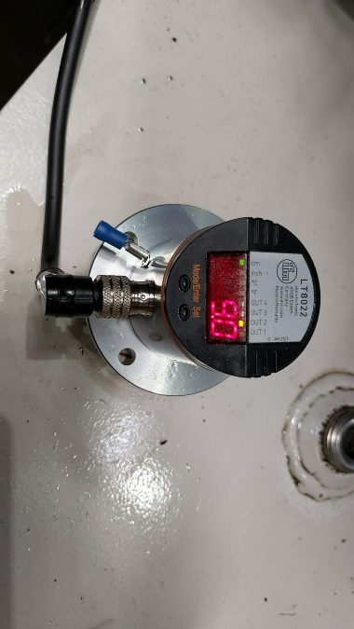
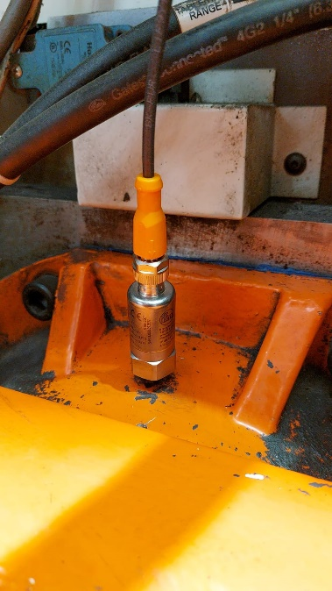
Analog Data Management
Sensor outputs
mA – long range
mV – short range due to signal drops
Multiple sensors Analog Scanner
4-20 mA
0-20 mA
mV (DC)
Pressure
Temperature
Level
Flow
Vibration
Sound
RPM
Pressure
Level
Vibration

Slide 17


Cloud & On-Premises
Cloud
No maintenance
Highly scalable
No CAPEX, only OPEX
Rapid upgrades
Easy redundancy
Global leaders / plugins
Need global Access
In house / outsourced expert
Costly at scale
On Premise
Private Network
In house data
Limited access on internet
Limited OPEX
Costly CAPEX
In house / outsourced expert
Needs firewall
Needs redundant hardware
Too much data at scale
Pros
Cons

Slide 18
Report Management
Hourly
Shift-wise
Daily
Weekly
Monthly

Slide 19
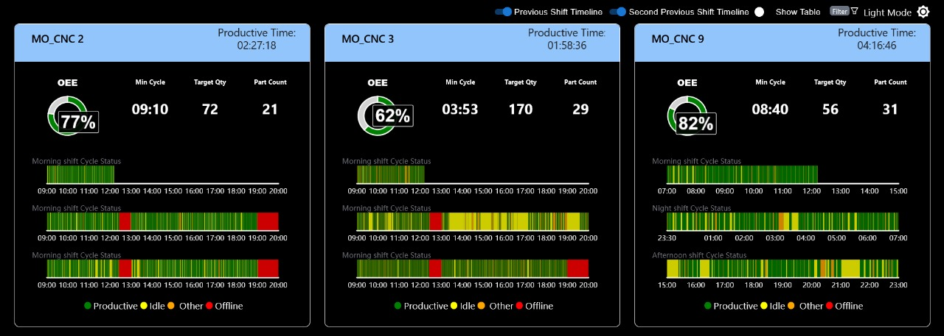
TV / Monitor View

Slide 20
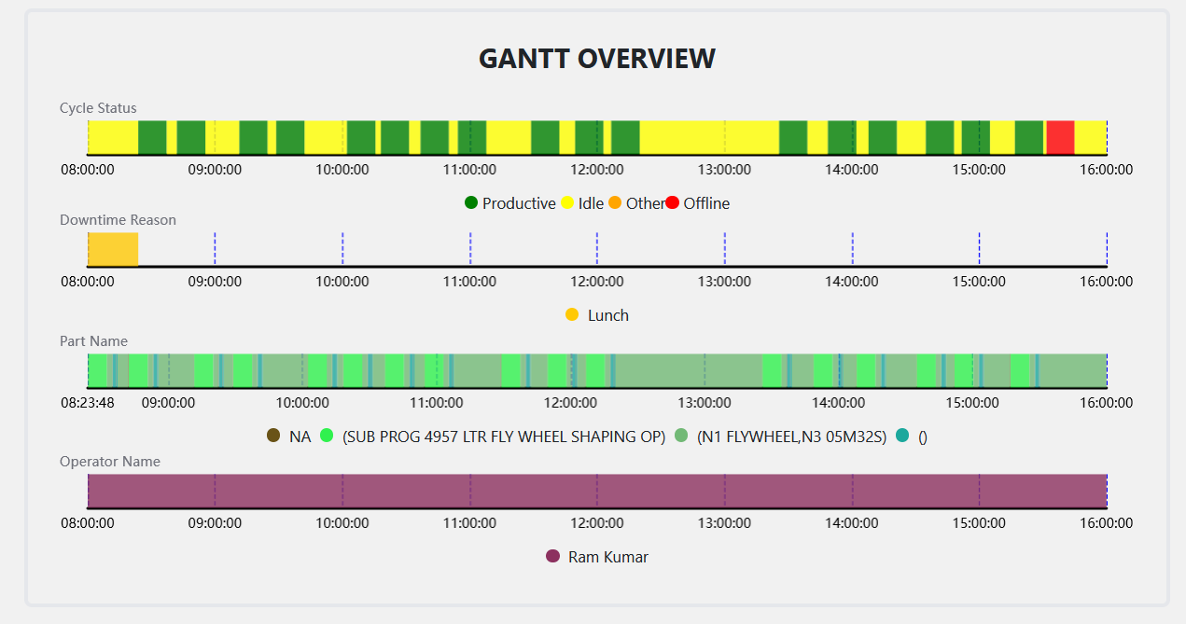
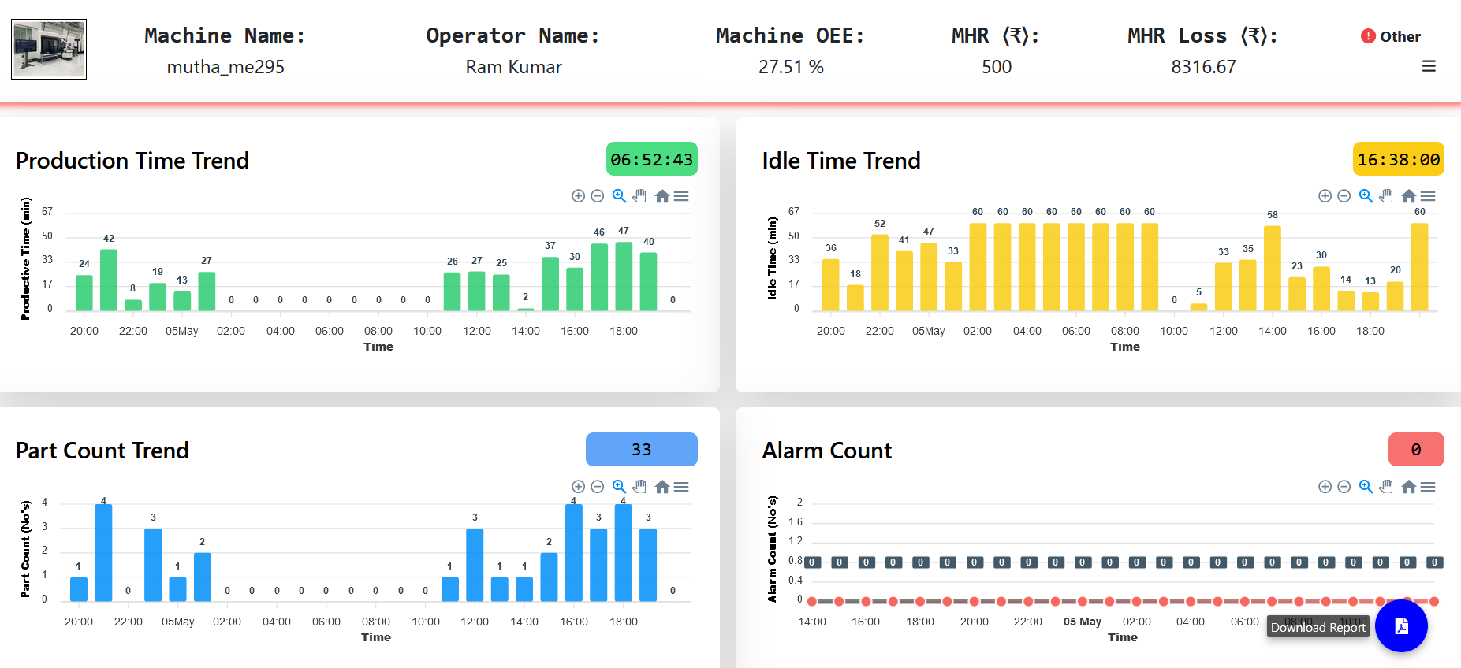
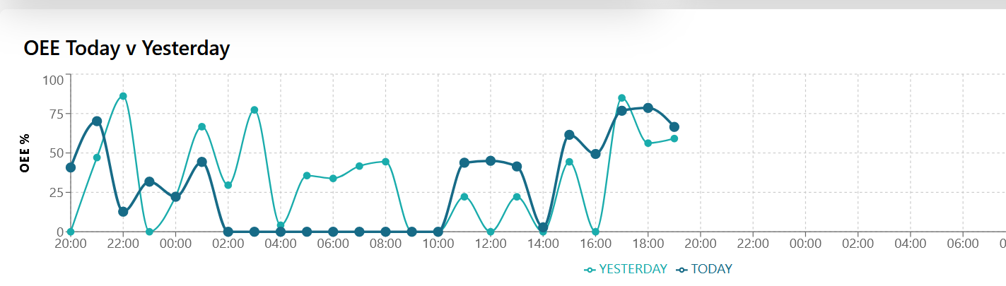
Dashboard Overview

Slide 21
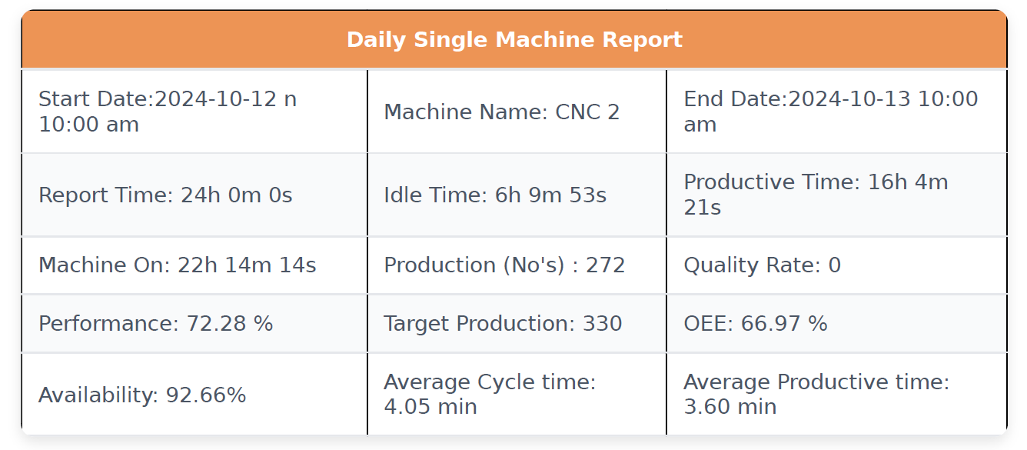
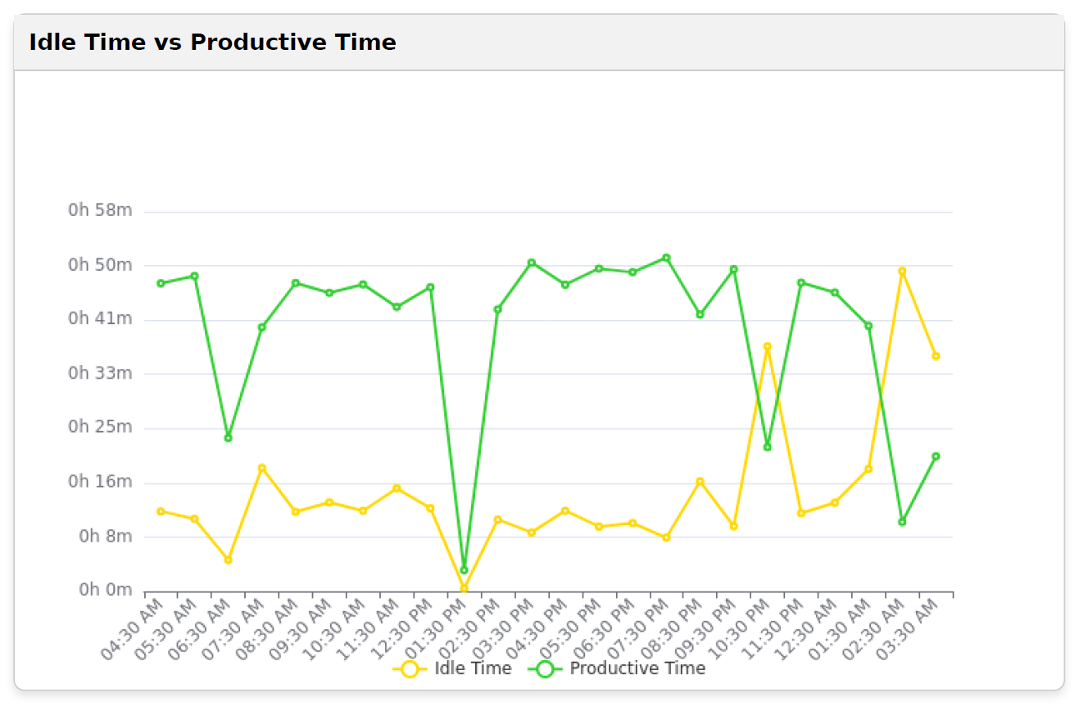
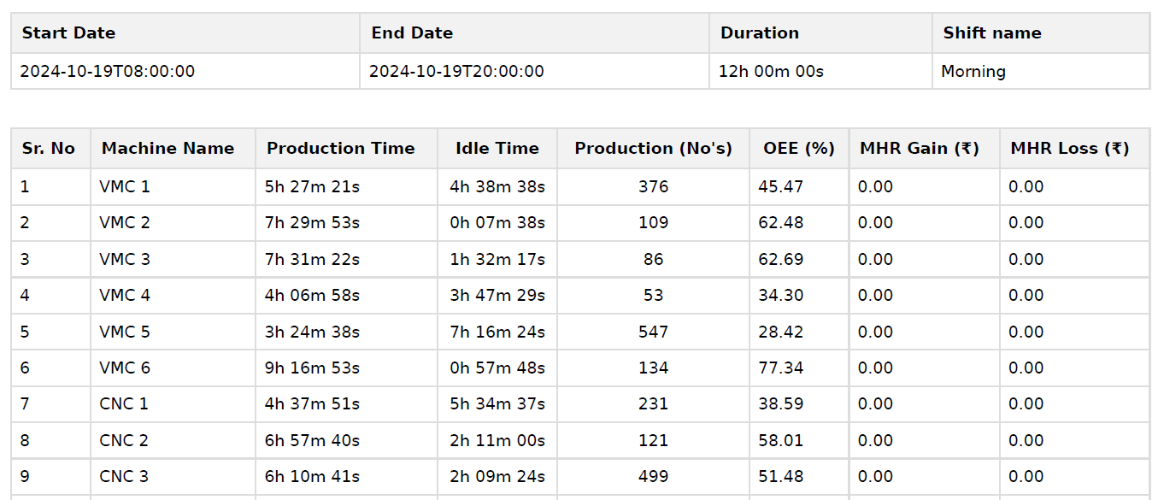
Data Analysis

Slide 22
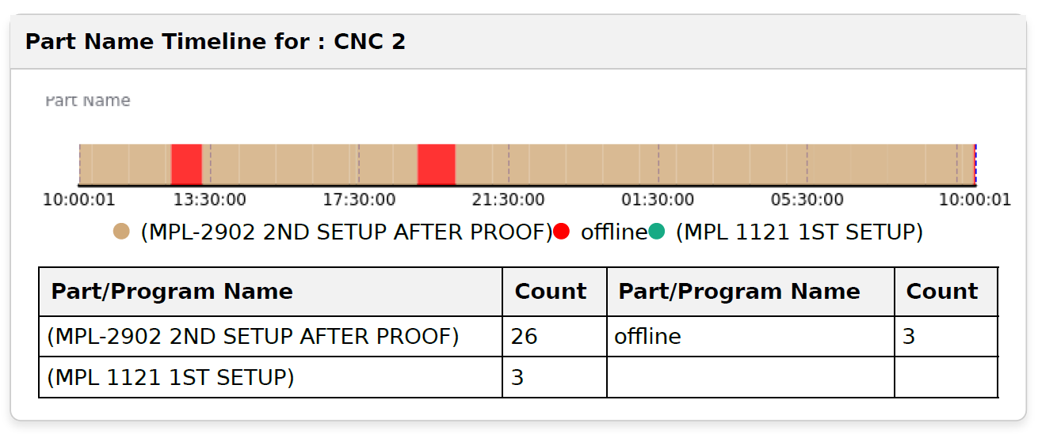
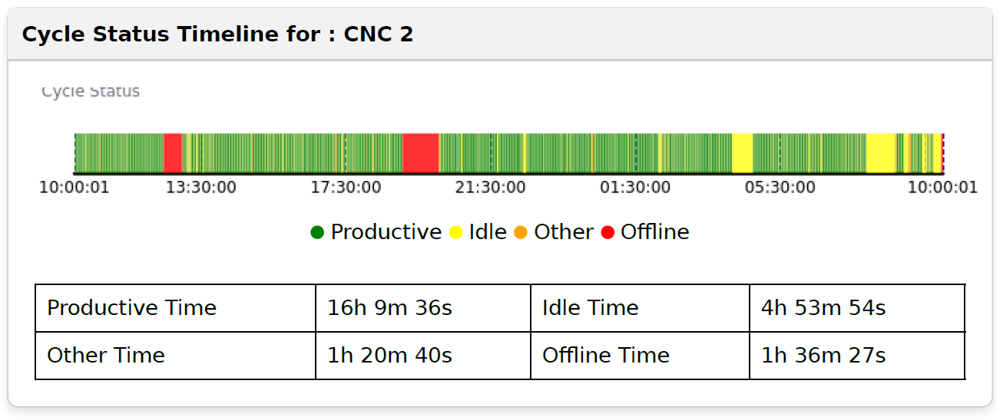
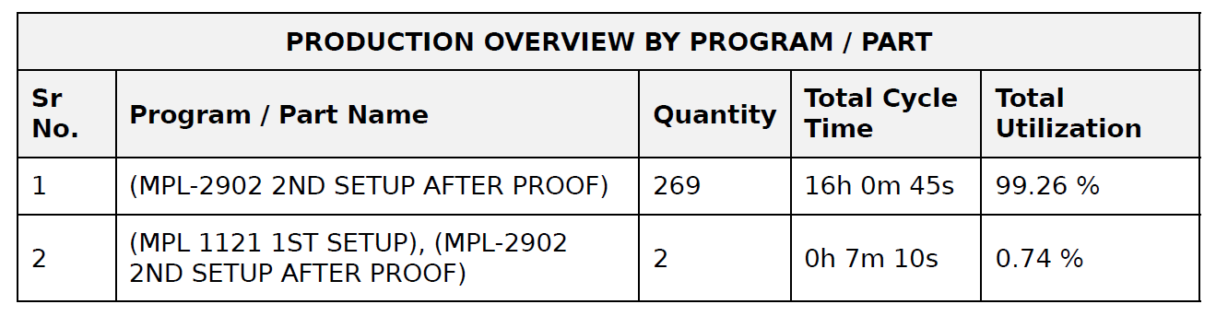
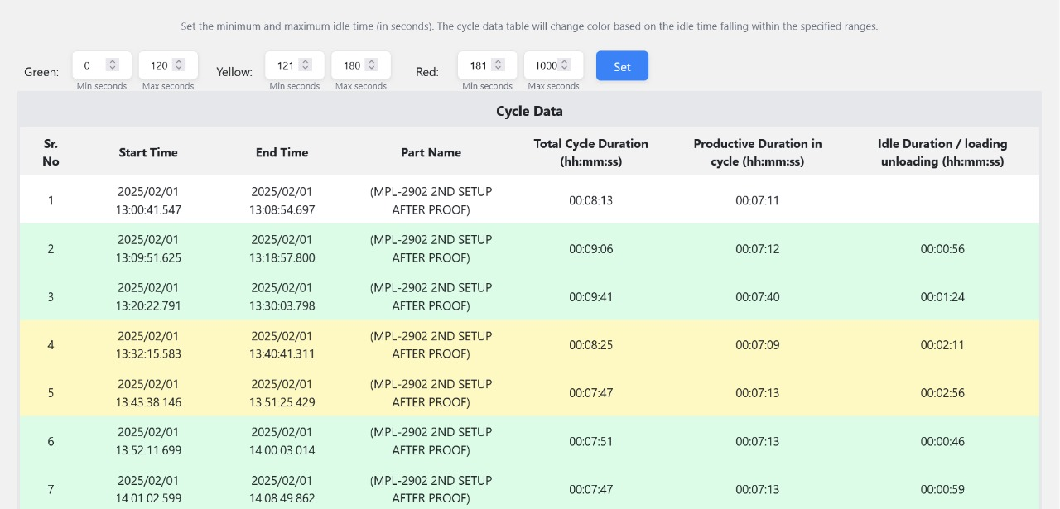
Data Analysis

Slide 23
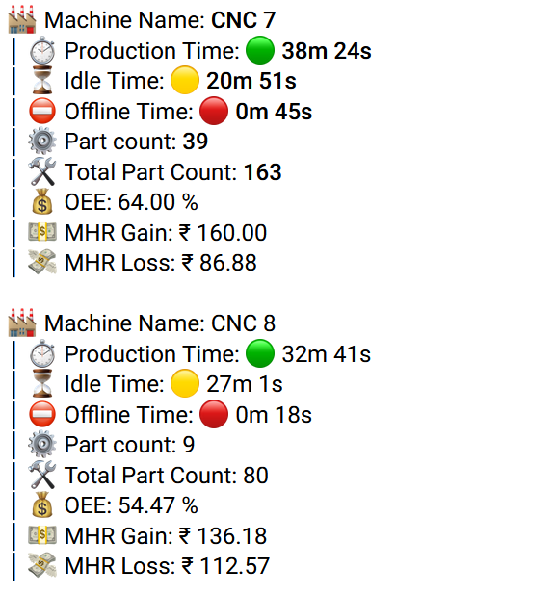
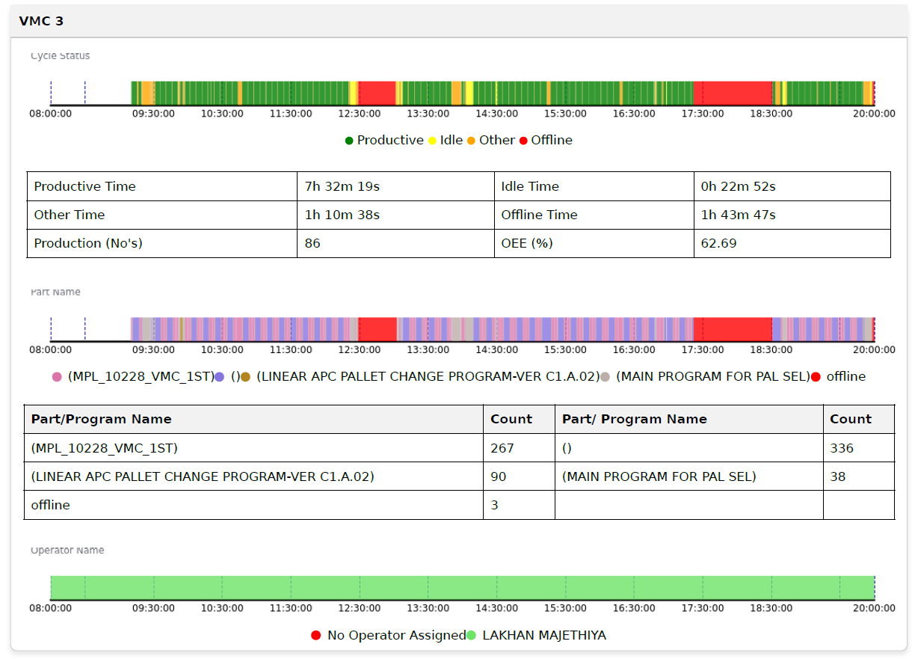
Data Analysis

Slide 24
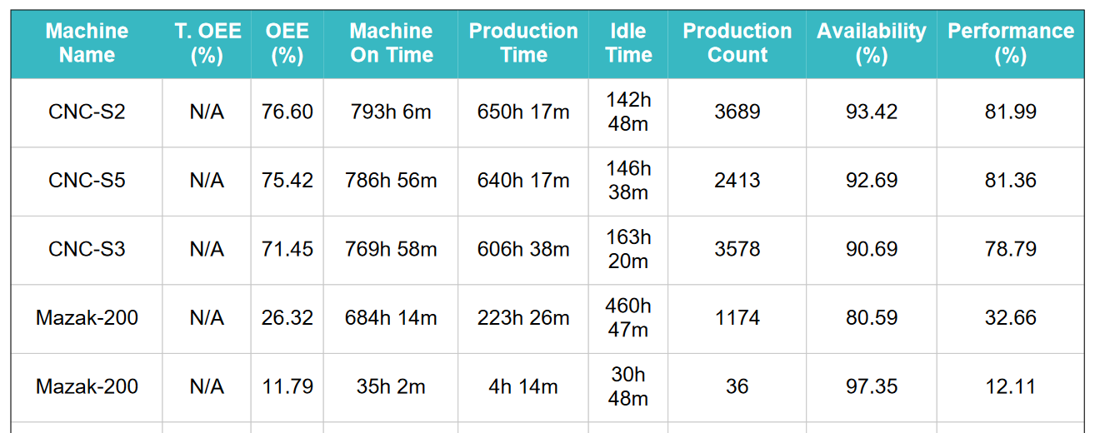
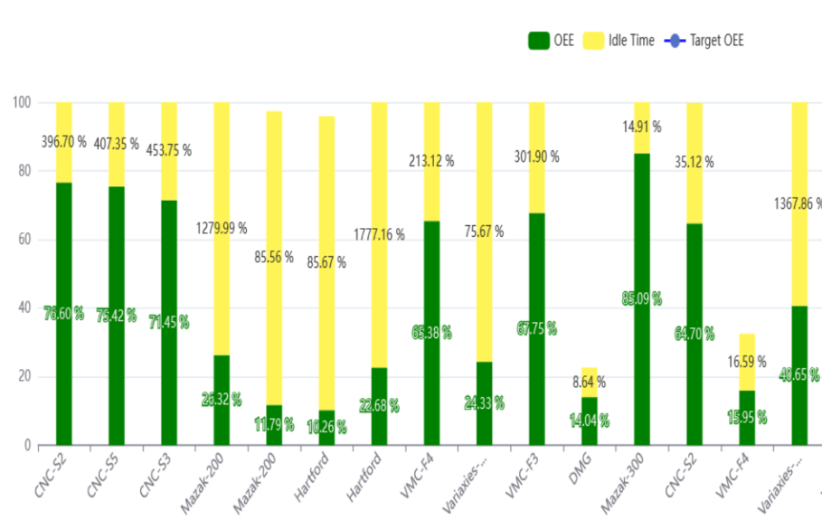
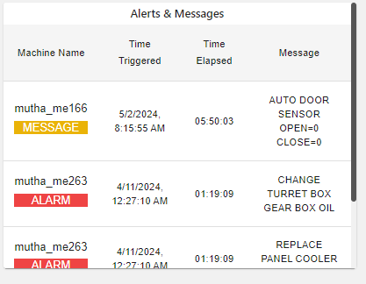
Data Analysis

Slide 25
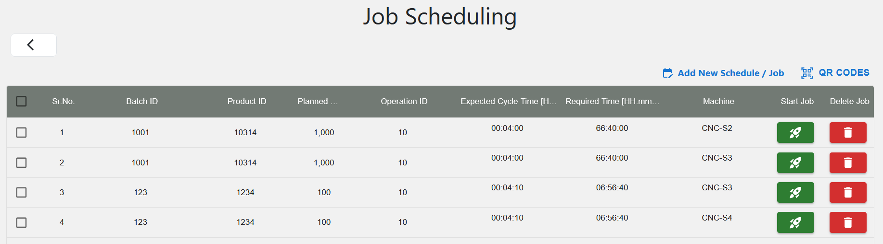
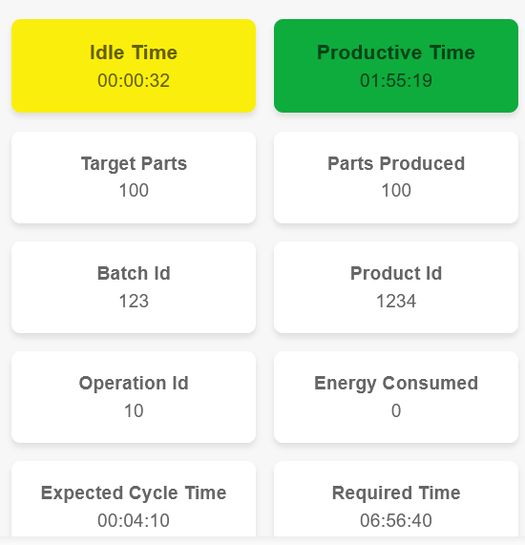
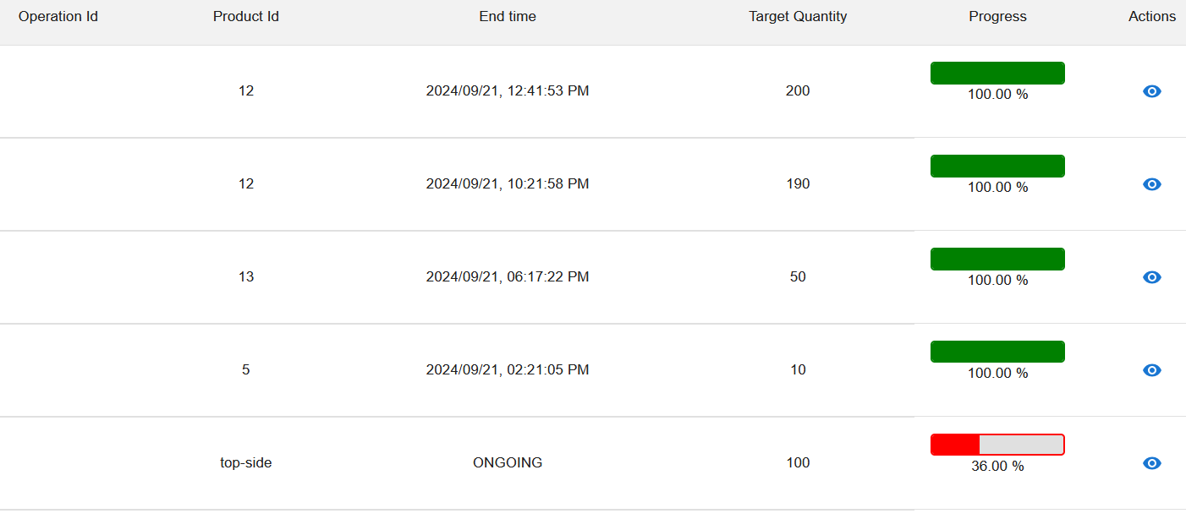
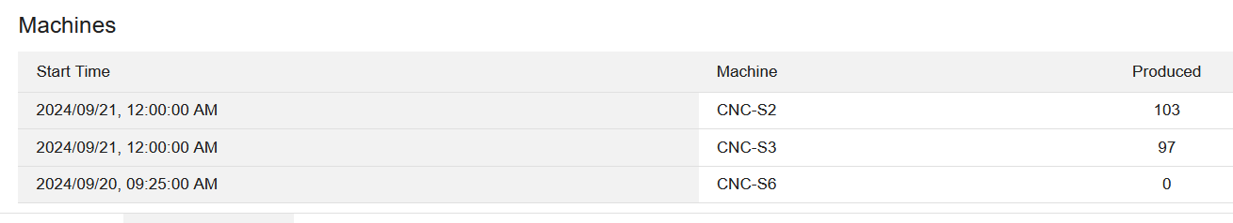
Job Scheduling

Slide 26
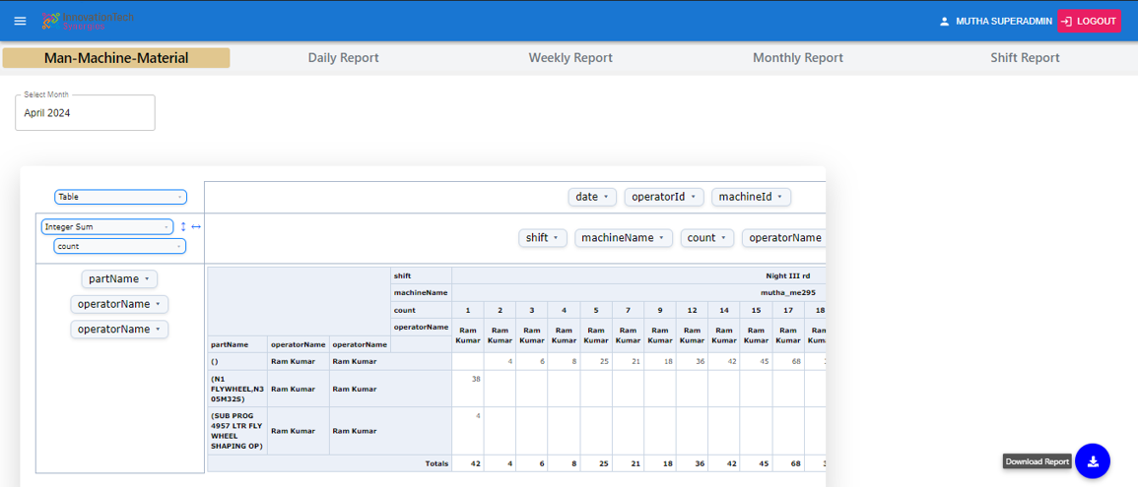
Man-Machine Report

Slide 27
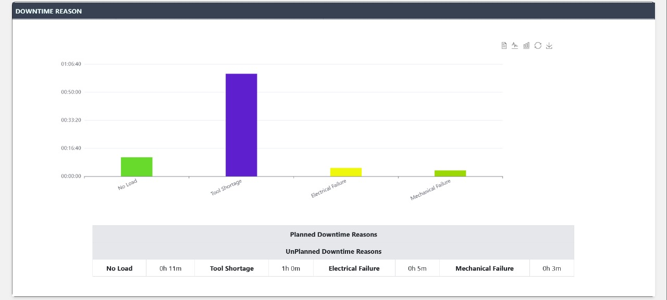
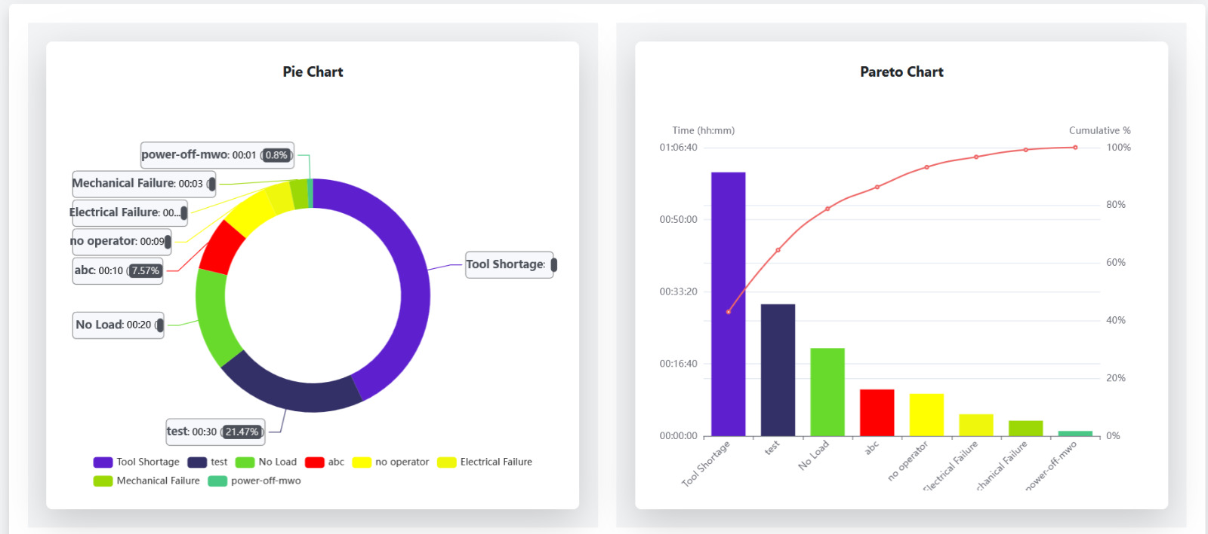
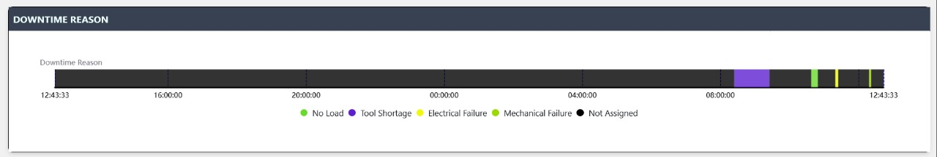
Downtime Analysis

Slide 28
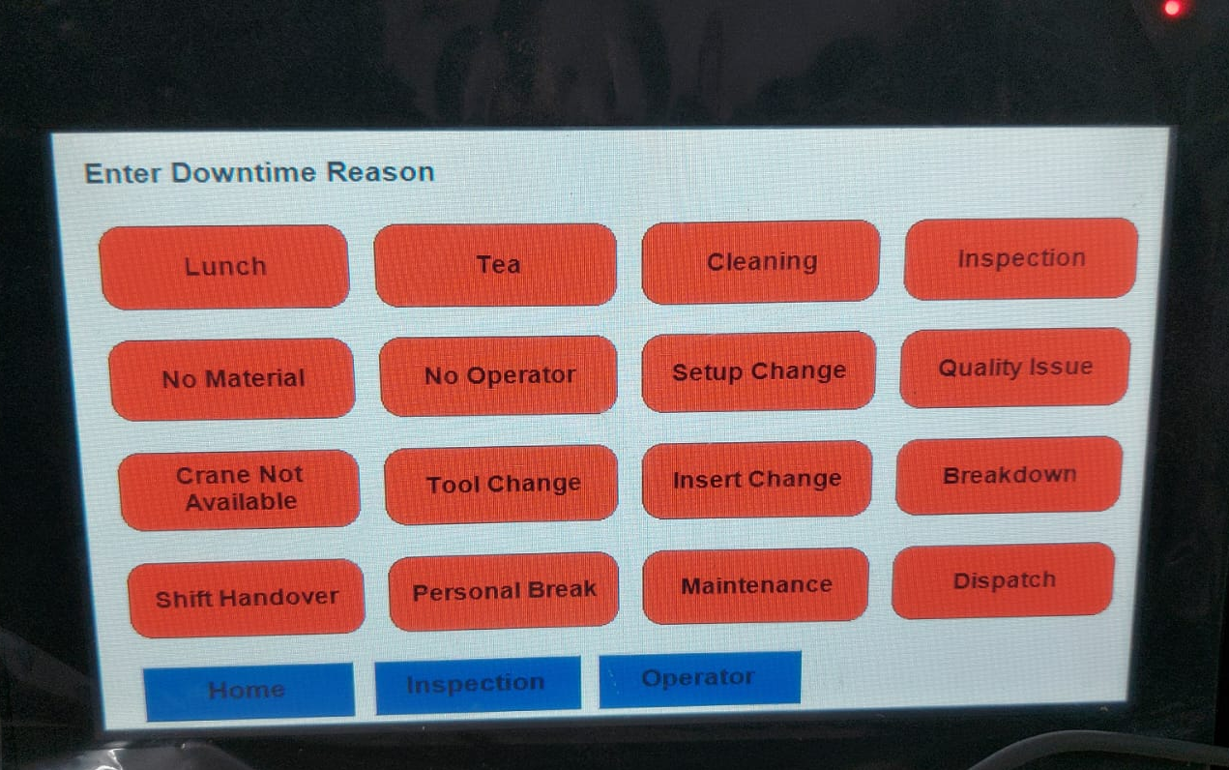
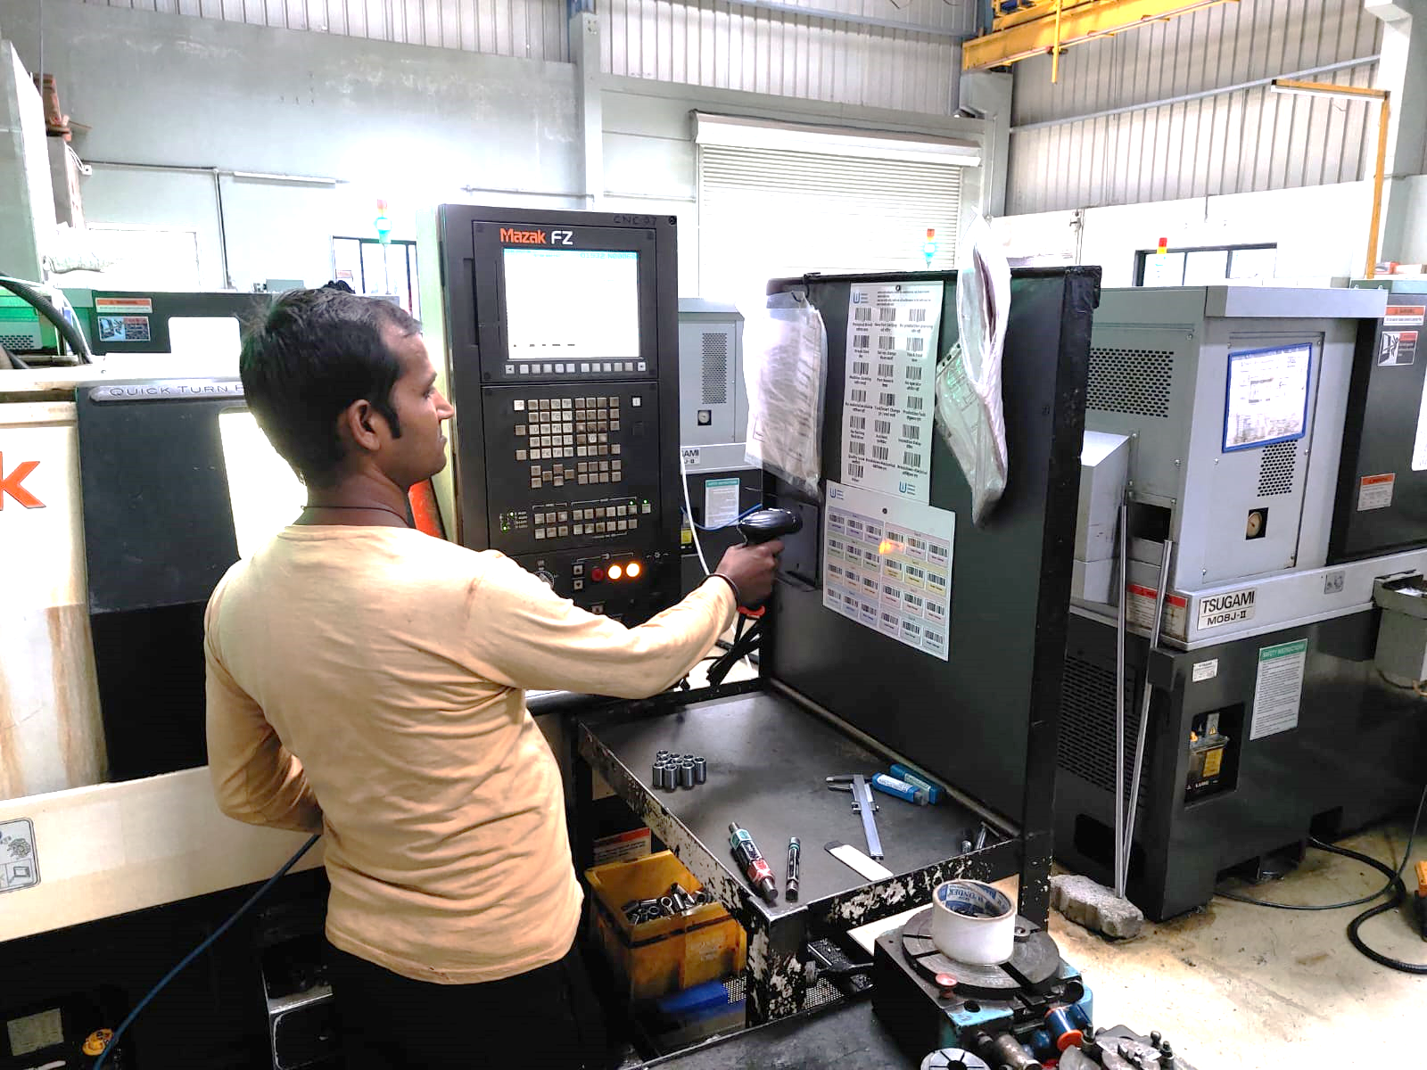
Downtime Capturing System
Option 1
Option 2
HMI – 3.5”, 5”, 7”, 10”
QR Scanning

Slide 29
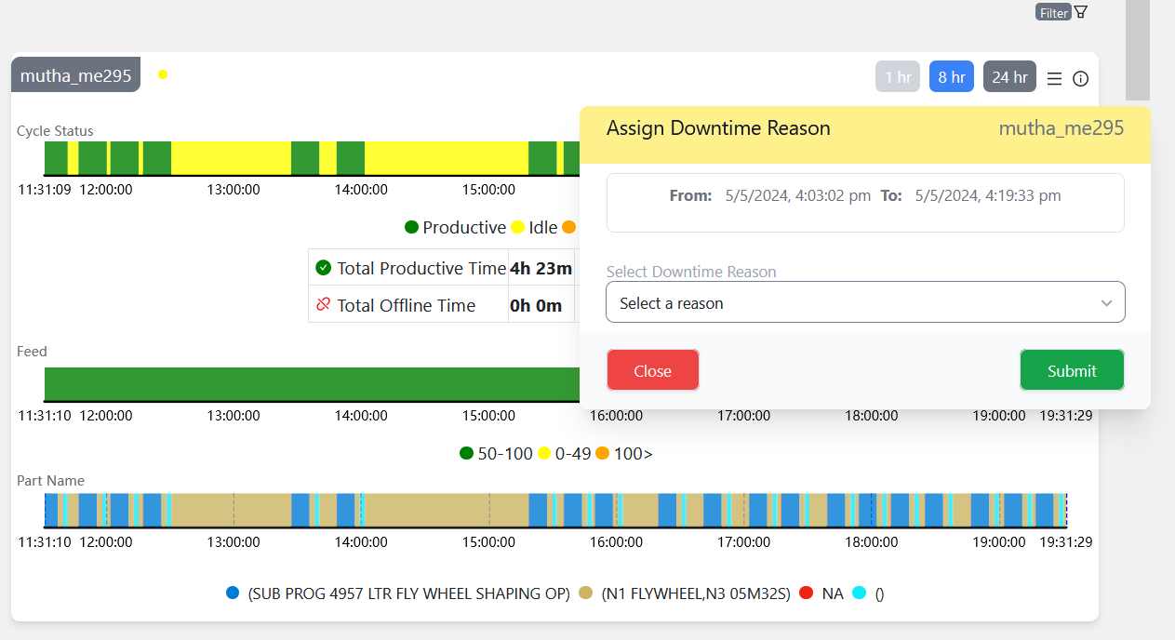
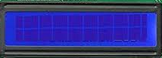
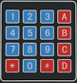
Options to Capture Downtime
Option 3
Option 4
Enter Downtime
1. Lunch 2. No Ma
InnovationTech Webpage
LCD 16 X 2 with Keypad

Slide 30
TOP Management MIS Dashboard
Company Name
Total Machines
360
Live Machines in Operation
250
Live Machines Idle
100
Live Machines Offline
10
Average Utilization
45%

Slide 31
TOP Management MIS Dashboard
All Plants Machines Summary
Sr. No. | Plant Name | Total Machines | Machines in Operation | Machines in Idle | Machines Offline | Average Utilization
1 | Plant 1 | 25 | 20 | 4 | 1 | 50%
2 | Plant 2 | 40 | 25 | 10 | 5 | 40%
3 | Plant 3 | 50 | 30 | 5 | 15 | 55%
4 | Plant 4 | 30 | 10 | 15 | 5 | 45%
5 | Plant 5 | 40 | 20 | 10 | 10 | 52%

Slide 32
TOP Management MIS Dashboard
Plant 1 Machines Summary
Sr. No. | Cell Name | Total Machines | Machines in Operation | Machines in Idle | Machines Offline | Average Utilization
1 | Cell 1 | 4 | 3 | 1 | 0 | 50%
2 | Cell 2 | 4 | 2 | 1 | 1 | 40%
3 | Cell 3 | 5 | 3 | 1 | 1 | 55%
4 | Cell 4 | 3 | 0 | 2 | 1 | 45%
5 | Cell 5 | 10 | 5 | 3 | 2 | 52%

Slide 33

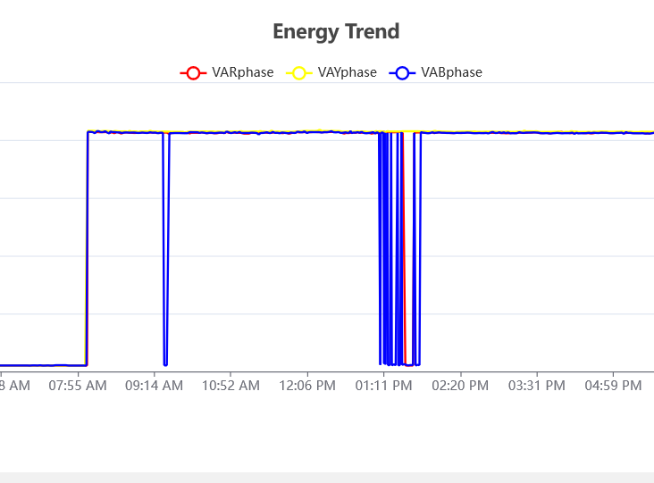
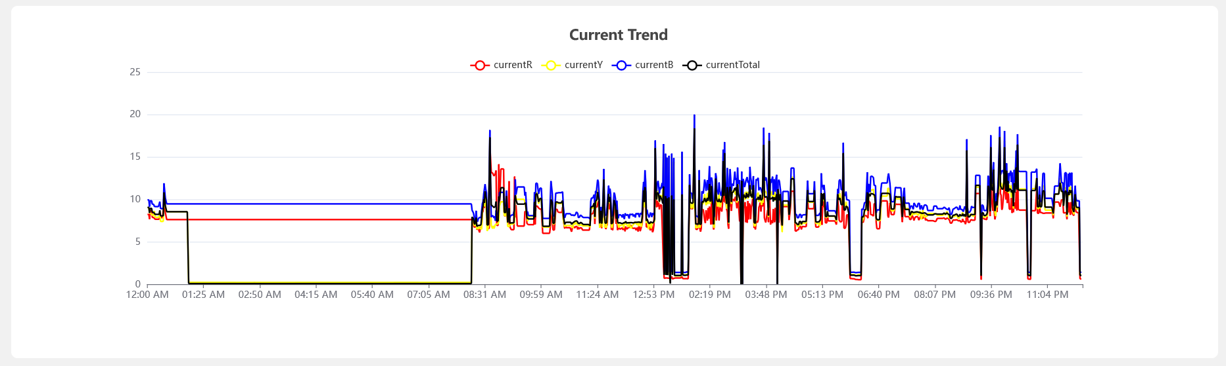
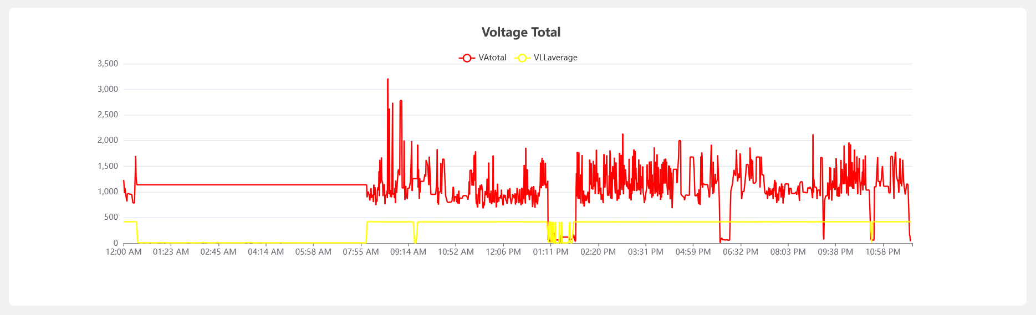
Energy Monitoring

Slide 34



Energy Monitoring

Slide 35



Predictive Maintenance
Available data from controllers
Energy Monitoring
Installation of External Sensors
Vibration Monitoring
Temperature Monitoring
Level and Flow Monitoring
RPM Monitoring
FFT Analysis

Slide 36




Vibration Monitoring

Slide 37


Vibration Monitoring Portable kit
InnovationTech Gateway
InnovationTech Analog Scanner
HMI
SMPS 24 V DC
Energy Meter
Vibration Sensor
Any Additional Sensor required like Temperature Sensor

Slide 38

Vibration Monitoring Portable kit
InnovationTech Gateway
InnovationTech Analog Scanner
SMPS 24 V DC
Energy Meter
Vibration Sensor
Any Additional Sensor required like Temperature Sensor

Slide 39


Fast Fourier Transform (FFT) Analysis

Slide 40



Fast Fourier Transform (FFT) Analysis

Slide 41

Smart Inspection for Industry 4.0 & QA 4.0
Intelligent, Connected, and Data-Driven Quality Assurance Systems.

Slide 42
Scope of Work for QA 4.0
A
Quality Monitoring
B
Inprocess Inspection
C
SQC
D
Establishing Traceability
Establishing Trends for CTQ Parameter
Sample Inspection
Operations wise, shift wise, component wise, Rejection Analysis
Digital Tracing..
Feeding Correction Factor ( Offset) to Mfg. Machine
Pre-Assembly Inspection
Process Capability indicators CP/CPK.
Laser Marking Integration
Pairing/grading for correct Assemblies
XR Charts
Linking Unique ID with QR Code
Trends of CTQ Parameters
Stopping The Machine in case of Abnormalities
Merging diff gauges on one inspection station
Pie Charts
Auto Scanning Of QR Code

Slide 43
QA 4.0 Impact
Key Benefits
Additional Benefits
Real-time data analysis
Improved product quality
Faster decision-making
Enhanced process efficiency
Predictive maintenance capability
Reduced waste and rework
Greater traceability and transparency
Higher compliance with industry standards
Increased customer satisfaction
Integration with Industry 4.0 systems
Automated quality control with minimal human intervention
Data-driven root cause analysis
Digital twin for quality simulation and optimization
Continuous learning from historical data for improved future performance
Scalability for multi-site operations
Reduced downtime due to predictive quality insights
Better alignment with global quality benchmarks
Customizable dashboards for real-time monitoring

Slide 44

Smart Quality Assurance for the Smart Factory
In the era of Industry 4.0, where digital transformation drives success, our gear and precession machined component inspection systems go beyond precision.
They integrate seamlessly into your smart factory ecosystem, delivering real-time insights, actionable data, and interconnected workflows.

Slide 45


A Vital Cog in Your Smart Factory Ecosystem
Our machine captures data and instantly shares it with your Manufacturing Execution System (MES) or Enterprise Resource Planning (ERP) systems, creating a unified data stream across your factory.
1
Our machine utilizes a unique identification system to assign a digital twin to every component, allowing for thorough traceability and real-time monitoring throughout the entire production process.
2
3
This connected approach ensures data integrity and enables data-driven decision-making throughout the manufacturing lifecycle.

Slide 46



Creating Digital Twins For Every Component
UID/QR / Bar Code Tracking
Laser Marking
Every inspected component is assigned a unique identification number or QR code, establishing a digital thread that links the physical part to its digital twin.
The inspection results are laser-marked directly onto the component, providing permanent traceability and a complete audit trail.

Slide 47


Reference Videos
Auto-Scanning UID
Laser-Marking

Slide 48


End to End Connectivity For Seamless Data Flow
The inspection machine captures detailed data in real time and automatically transmits it to your preferred systems, allowing for remote monitoring and analysis.
This real-time data flow enables immediate insights into quality metrics and facilitates continuous improvement through statistical quality control (SQC) analysis.

Slide 49



Enabling Closed Loop Manufacturing
Dynamic Correction Factors
Tool Wear Monitoring
The system automatically adjusts manufacturing tools based on inspection data, ensuring consistent quality and reducing scrap rates.
Monitor tool wear and identify potential deviations, enabling proactive maintenance and minimizing downtime.

Slide 50



Empowering Data-Driven Decision-Making
100%
100%
Real-Time Visibility
Actionable Insights
Our system provides a comprehensive view of your production data, including detailed inspection results, quality metrics, and performance trends.
adapting to today’s quasi-Production
The intuitive dashboard visualizes key data points, presenting critical information in a clear and concise manner for informed decision-making.

Slide 51


Reference Data
Day & Date-Wise Inspection Data Overview
Inspection Report with Trend Analysis

Slide 52



Predictive & Proactive Quality Management
Predictive Analytics
Our system analyzes historical data and current trends to predict potential issues, enabling proactive intervention before defects occur.
Proactive Recommendations
The system recommends necessary adjustments to manufacturing tools, ensuring consistent quality and preventing future defects.
Reduced Downtime
Proactive quality management minimizes production downtime by preventing issues before they disrupt the workflow.

Slide 53


Complete Traceability & Process Transparency
Laser Marking
UID-Driven Data Tracking
Each part is uniquely identified with laser-marked QR codes containing batch information and inspection results, ensuring complete traceability.
All production data is linked to individual parts using unique identifiers (UIDs), providing a comprehensive audit trail for full transparency.

Slide 54

Scalable & Modular For your Evolving Needs
Modular Design
Scalable Architecture
Our inspection machines are designed with modularity in mind, allowing for customization and seamless integration with existing systems.
Continues Modification in our Machine Is Possible If Needed
Our systems can scale effortlessly as your production needs grow, ensuring long-term value and adaptability.

Slide 55

Most flexible multi gauging for shafts and spline inspection- Measurement

Slide 56

Bring Digital Transformation in Manufacturing
Our systems enable manufacturers to transition seamlessly into Industry 4.0, ensuring smarter, faster, and more reliable processes with intelligent automation and actionable insights.
We provide interoperability with QA and production systems, delivering real-time data insights for agile manufacturing.

Slide 57

Empowering Human-Machine Collaboration
User-Friendly Interfaces
Intelligent Automation
Our systems feature user-friendly interfaces that empower operators with real-time monitoring and control.
They provide intuitive dashboards and visualizations for easy data interpretation and decision making.
By blending the expertise of human operators with the precision of intelligent automation, our systems ensure the best of both worlds for quality assurance.
This reduces human intervention in repetitive tasks, freeing operators to focus on higher-level problem-solving.

Slide 58

Human-Machine Collaboration

Slide 59

Ready to Transform Your QA Process?
Streamlined QA
Increased Efficiency
Our systems streamline your QA process by integrating real-time data, intelligent automation, and human expertise, resulting in faster cycle times, fewer errors, and improved product quality.
Our solutions drive operational efficiency by optimizing processes and reducing waste. They empower you to make informed decisions based on real-time insights, improving productivity and resource utilization.
Enhanced Compliance
We enable you to meet industry standards and regulatory requirements through automated data collection, reporting, and traceability. This ensures compliance and reduces the risk of product recalls or non-conformance issues.

Slide 60

The Third Layer | Transformation
The third layer involves a comprehensive evaluation of the existing product and production processes. This stage primarily focuses on transforming the production process through the deployment of advanced machinery and technology. InnovationTech will drives the establishment or restructuring of the Production process, including extensive training for employees and upgrading of its tool set. The primary goal is to optimize the entire production process, achieving a 50% Boost or cost reduction by lowering the Cost Per Component (CPC) and improving Overall Equipment Efficiency (OEE). This strategic transformation enhances operational efficiency and ensures sustainable growth in production capabilities.
1
Survey
2
Blue Print
3
OEE
6
50 % Boost
5
CPC Streamline
4
Benchmarking

Slide 61

The InnovationTech way
A
Mindset
B
Culture
C
Technology

Slide 62

Additional Training
InnovationTech synergies will deliver specialized technical training on I 4.0 & Q 4.0 technologies implemented within the factory. This training ensures employees are well-equipped with the knowledge and skills needed, facilitating a smooth transition and effective adoption of new systems. It enhances operational efficiency and supports successful technology integration within the workplace.

Slide 63

SMART/ SIGMA
Thank You…..

